Slide 1

Step 5: Grouping the documents
Post Bucketing – Selecting the Best Evidence
A
B
C
D
E
D
E
Harsh Environmental Conditions
Lack of Settler Skills
Poor Relations with Indians

Slide 2
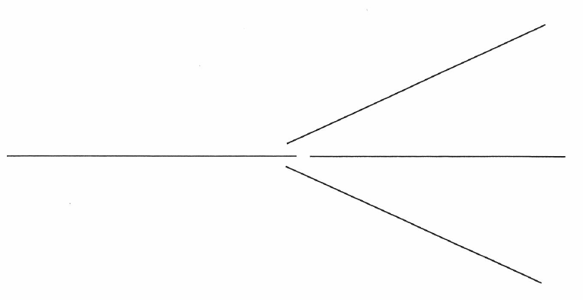
The DBQ Project Method
Step 6: Writing
From thrash-out to essay

Slide 3
Guided Essay
Early Jamestown: Why Did So Many Colonists Die?
I. Introduction
Grabber
Background information on settlement of Jamestown (time, place, story)
Restatement of the question
Definition of “early”
Thesis (claim) and Roadmap: Colonists died in early Jamestown because of _____ (number of) problems. These problems were ___________, ____________, and __________________.
II. Body Paragraph #1 (Problem One: _____________)
Baby Thesis: The first reason Jamestown colonists died was
Evidence: Use the documents to provide two or three details about Problem One.
Argument: This evidence helps explain why so many colonists dies because
III. Body Paragraph #2 (Problem Two: _____________)
Baby Thesis: The second reason Jamestown colonists died was
Evidence: Use the documents to provide two or three details about Problem two.
Argument: This evidence helps explain why so many colonists dies because
IV. Body Paragraph #3 (Problem Three: _____________)
Baby Thesis: The third reason Jamestown colonists died was
Evidence: Use the documents to provide two or three details about Problem three.
Argument: This evidence helps explain why so many colonists dies because
V. Conclusion
A. Restatement of thesis
B.

Slide 4
