Slide 1
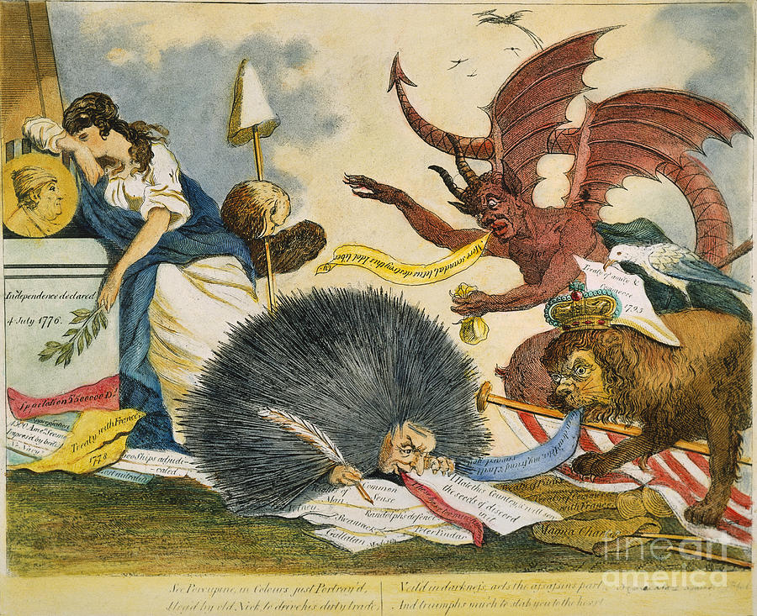
Federalist Era Cartoon, c1799

Slide 2
So, what do you see?
Make a list of 15 things that you see in the cartoon
For example: bald eagle

Slide 3
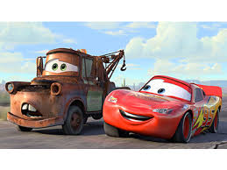
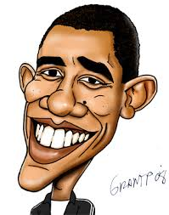
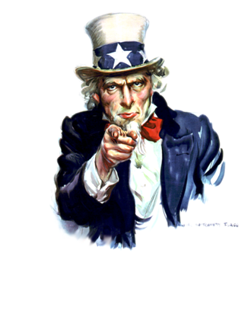
Parts of Political Cartoons
What do these words mean? Look them up online if your group isn’t sure. Prepare to share an example of each.
Personification
caricature
Symbolism
Personification: giving human characteristics to animals or inanimate objects
caricature: a picture of a person or thing in which certain characteristics are exaggerated in order to create a comic or grotesque effect.
Symbolism: the use of images or words to represent ideas or qualities.

Slide 4
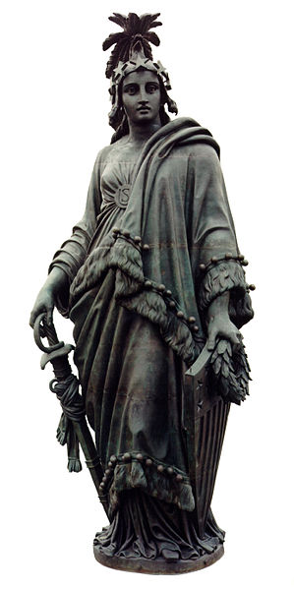
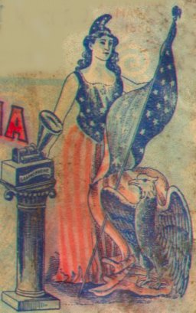
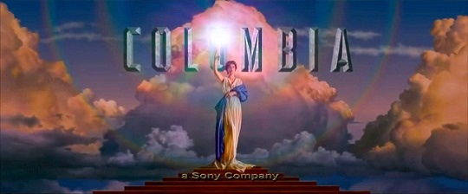
Columbia
Statue on top of the Capitol Building

Slide 5
Symbols
Draw stars next to the items on your list that you think are symbols and label what you think they mean.
Do you think this an anti-Federalist or anti-Republican cartoon? Why?

Slide 6
Discussion
What is the profession of the Porcupine? How do you know?
What country does the lion represent? How do you know?
Does the cartoonist think the lion is good or bad? How do you know?
Which country does the lady represent? How do you know?

Slide 7
The porcupine is a writer
writing “I hate this country and will sow the seeds of discord in it.”
tramples the names of Republican politicians
Real Name: William Cobbett, pseudonym "Peter Porcupine,“ wrote many pro-British articles

Slide 8
The crowned lion represents the British King
It stands on
an American flag,
a Phrygian cap (symbol of liberty)
treaties between Britain & France
It encourages the writer: “Go on dear Peter [the writer’s name], my friend & I will reward you”.

Slide 9
The evil demon represents the Federalists
“Traytor” [sic] written on its chest
says “More scandal, let us destroy this idol liberty” [the woman]
offers the writer a bag of coins as a reward
The bird, represents American diplomat John Jay
holds the Jay Treaty between Britain & the U.S.
Republicans consider this a violation of U.S. neutrality

Slide 10
The sad woman is Columbia
Her staff & Phrygian cap (symbols of liberty) are held by a bald eagle which glares at the Federalists and British symbols.
The pedestal is engraved with "Independence declared 4th July 1776" & has a portrait of Benjamin Franklin.
On the ground:
paper inscribed with "1500 Ame[rica]n seamen impressed by the British“
reminder of the British harassment of American shipping.
The 1778 treaty of alliance between France and the United States is torn

