Slide 1
George Washington: Preview

Slide 2
Directions
Move to the NORTH side of the room if the statement is TRUE
Move to the SOUTH side of the room if the statement is FALSE
OR
Move to the corner of the room that matches the answer you choose.

Slide 3
North=True South=False
﻿When Washington was a boy, he chopped down a cherry tree and then confessed to doing it because he was so honest.

Slide 4
4 Corners
Washington had dentures (false teeth) made of
NE= ivory
SE= gold
SW= dog teeth
NW= wood

Slide 5
North=True South=False
When Washington became President, he wanted to be called by the title, “Your Excellency.”

Slide 6
North=True South=False
Washington was the first President to veto a bill.﻿

Slide 7
4 corners
President Washington led an army to stop a rebellion led by farmers who didn’t want to pay taxes. This was known as the
NE= XYZ Affair
SE= Shays’ Rebellion
SW= Alien & Sedition Acts
NW= Whiskey Rebellion

Slide 8
North=True South=False
In President Washington’s Farewell Address, he supported the formation of the first political parties: Federalists and Democratic-Republicans.

Slide 9
4 Corners
President Washington thought that the USA should form an alliance with which foreign country?
NW= France
SE= Spain
SW= Great Britain
NE= none

Slide 10
4 Corners
Washington served ____ term(s) as President. ﻿
NE= 1
SE= 2
SW= 3
NW= 4

Slide 11
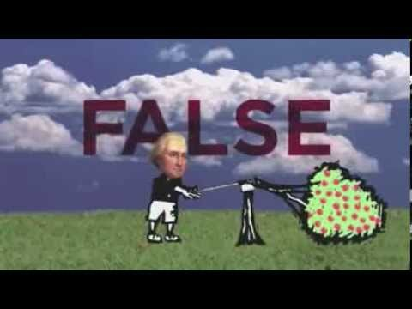
Check your Answers

