Slide 1
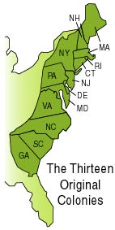
Thirteen English Colonies
1607-1754

Slide 2
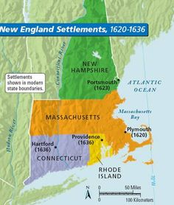
New England Colonies
Massachusetts, Rhode Island, New Hampshire, Connecticut

Slide 3
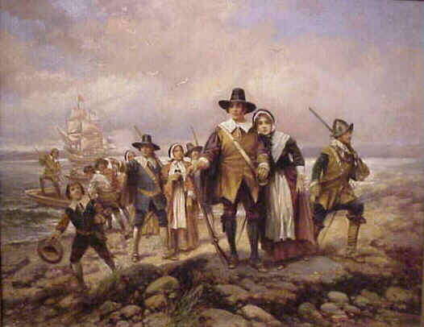
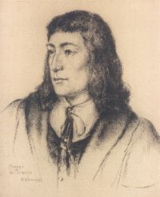
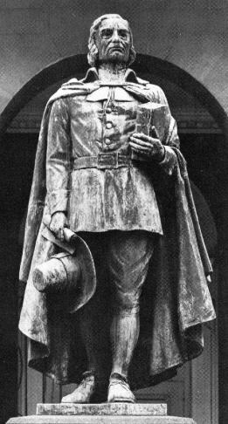
New England Colonies
Founded: for religious reasons
Mostly Puritan Christianity
Often intolerant of other religions
Theocracy- Religion highly influences government
Roger Williams
Edward Percy Moran
Pilgrims Landing
Circa 1900s
Thomas Hooker

Slide 4
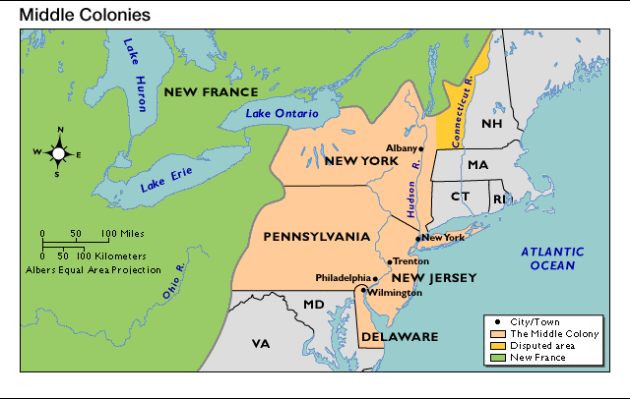
Middle Colonies
New York, New Jersey, Pennsylvania, Delaware

Slide 5
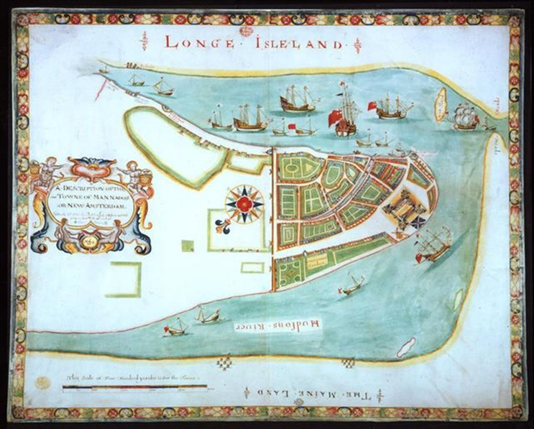
Middle Colonies
Founded: both for economic & religious reasons
Pennsylvania: different religions could live together peacefully
New York: originally a Dutch colony (New Amsterdam)
William Penn, a Quaker

Slide 6
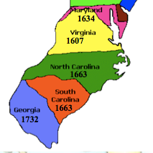
Southern Colonies
Maryland
Virginia
North Carolina
South Carolina
Georgia

Slide 7
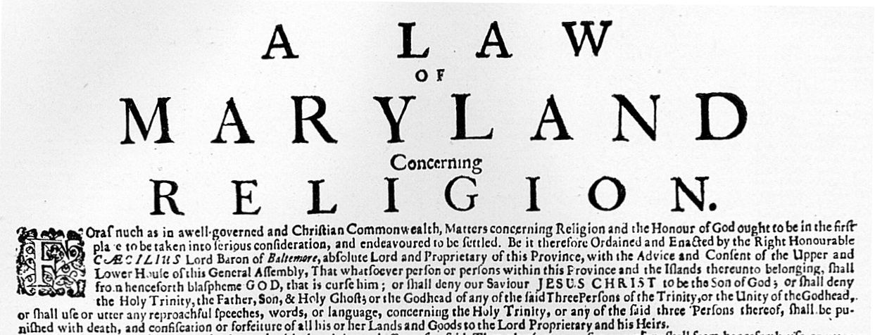
Southern Colonies
Founded: mostly economic, religious, & political reasons.
Maryland: haven for Catholics
Georgia: buffer between SC and Spanish Fla.

