Slide 1
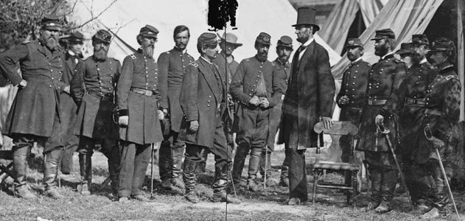
What Caused the Civil War?
DBQ: Document Based Question

Slide 2

The DBQ Project Method
Step 1: The Hook (Engaging the students)
Step 2: The Background Essay (Building Context)
Step 3: Clarifying the Question (Defining Key Terms & Pre-bucketing)
Step 4: Close Analysis (Understanding the Documents )
Step 5: Grouping the Documents (Post-Bucketing)
Step 6: Writing (From Thrash-out to Essay)

Slide 3
The DBQ Project Method
Step 1: The Hook
Engaging the students

Slide 4
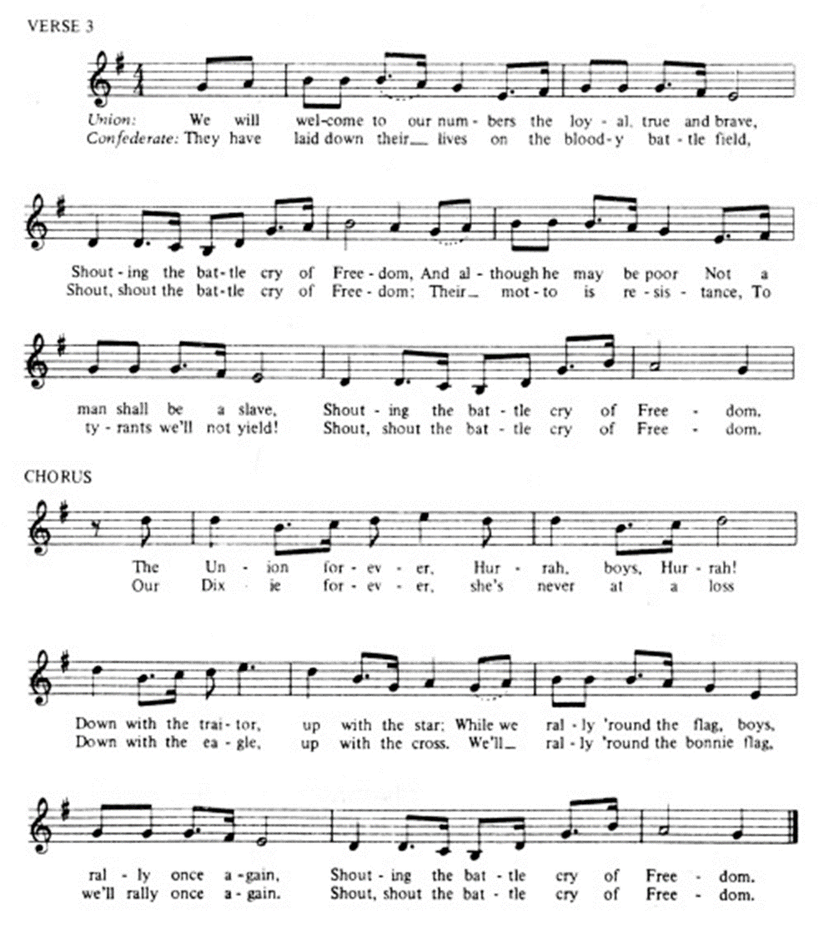
Hook: Understanding Point of View
The Battle Cry of Freedom was sung by both Yankee and Confederate soldier in the their camps and when on the march. North and South, the melody was the same, but the words were different. Compare the third verse and the chorus of the Union and Confederate versions.
Judging from these lyrics alone, for what was each side fighting? In your analysis, be sure to consider the meaning behind such words as “traitors,” “tyrants,” and “freedom.”

Slide 5


Slide 6




Confederate Flags
“Stars and Bars.” The first national flag of the Confederate States of America with 13 stars
“Stainless Banner.” The second national flag of the Confederate States of America
“The Blood-Stained Banner.” The third national flag of the Confederate States of America.
The Battle Flag of the Army of Northern Virginia.

Slide 7
The DBQ Project Method
Step 2: The Background Essay
Building context
Time, place and story

Slide 8
1)
9)
2)
6)
10)
3)
13)
7)
4)
8)
11)
5)
14)
12)

Slide 9
The DBQ Project Method
Step 2: The Background Essay
Time
Place
Story
(related to question)

Slide 10
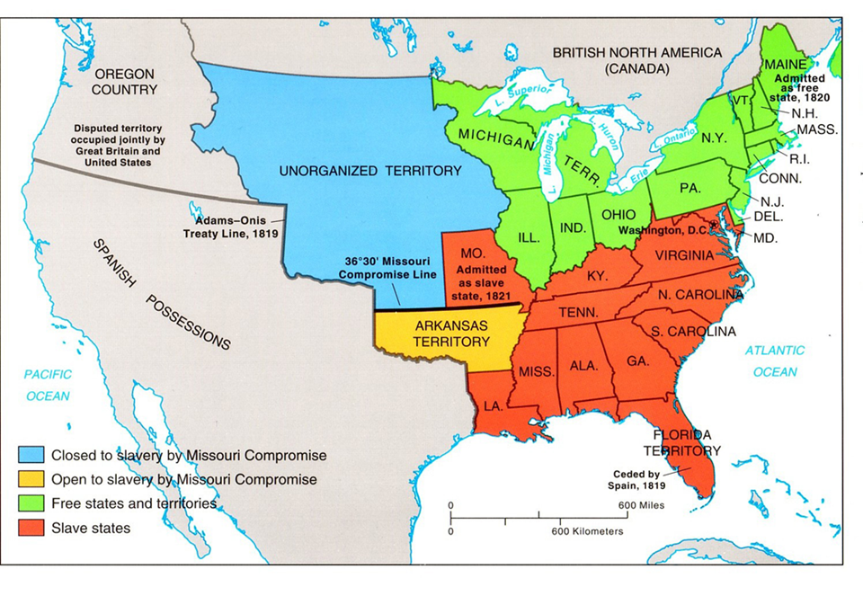
9) Missouri Compromise

Slide 11
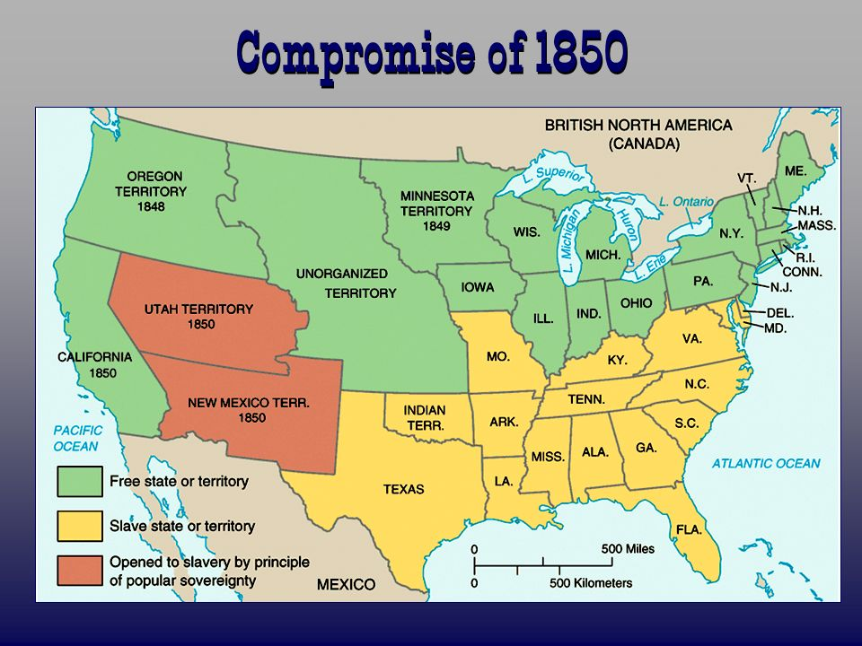
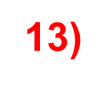

Slide 12
Background Summary
Individually: Write a 2-3 sentence summary that includes time, place and major story events.
key ideas: 1787, 1861, United States, North, South, slavery, westward expansion/territories, conflict, compromises, failure

Slide 13
The DBQ Project Method
Step 3: Clarifying the Question
What Caused the Civil War?

Slide 14
1
Step 3: Clarifying the Question
Part One: Defining Key Terms
What
Caused the Civil War?
To make
Something happen
Conflict between people in the same country
Started
1861

Slide 15
Step 3: Clarifying the Question (continued)
Part Two: Identifying the Task
Discussion Question:
Does the question ask you to come up with several reasons for the Civil War or one overall reason?
Rewrite the question as a statement in your own words, including dates.
***This will be part of your thesis statement.

Slide 16

Step 3: Clarifying the Question
Pre-bucketing
Directions: Using any clues from the discussion and documents you’ve read so far, predict the analytical categories for the buckets.
Cause #1
Cause #2
Cause #3
Notes:
Think about analysis in two large categories: close analysis and gross analysis
Close Analysis refers to breaking dowj an individual document into categories like fact, inference, main idea, and point of view.
Gross anaysis refers to the clustering or bucketing of documents into analytical categories.
This gives students a visual framwork for their analysis and eventually their paper. Pre-bucketing provides reading readiness – a purpose for reading.
Buckets eventually become body paragraphs; an essay framework.

Slide 17
Step 3: Clarifying the Question
Pre-bucketing
#1 Ideas About
the Morality
of Slavery
#2 Differing
Economies
#3 Failure of
Political
Compromise
Notes:
Think about analysis in two large categories: close analysis and gross analysis
Close Analysis refers to breaking dowj an individual document into categories like fact, inference, main idea, and point of view.
Gross anaysis refers to the clustering or bucketing of documents into analytical categories.
This gives students a visual framwork for their analysis and eventually their paper. Pre-bucketing provides reading readiness – a purpose for reading.
Buckets eventually become body paragraphs; an essay framework.

