Slide 1
Liberty’s Stand
Comic Strip

Slide 2
Liberty’s Stand Comic Strip
In groups, you are going to narrate a comic strip about a father describing the events leading up to the Revolutionary War to his daughter and why he is choosing to join the Continental Army
Cut apart the comic strip and paste the cells onto a poster or make a booklet.
Write captions/Dialog for each cell to help tell the story

Slide 3
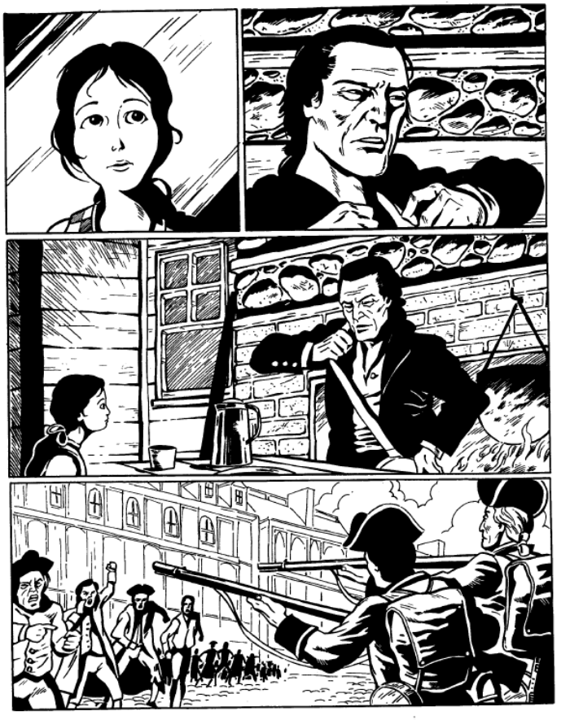
Before you Cut: Number each cell (box)
1
3
4
2
5
6
7
8

Slide 4
13
9
14
10
12
11

Slide 5
Historical Events
(Number = cartoon cell with major event)
4. Boston Massacre
5/6. Tea Party
8. Intolerable Acts
9. Minutemen militia called to Action
10. Fighting in Lexington/Concord
14. Dad leaving to joining colonial militia

Slide 6
GUidelines
You must include:
  captions/dialog that explain
    the pictured events
    why dad is choosing to join the Continental Army.
  Chronology
  format as a booklet or poster
  Title
  Color
  your names
Roles
  Write (but everyone helps create dialog)
  Cut
  color
  Layout
  glue

Slide 7
Grading Rubric

